Slide 1

DEPARTMENT OF COMPUTER SCIENCE AND ENGINEERING
Professional Training I
Public School Performance And Attendance Dashboard
PROJECT STUDENT GUIDE
Sowntharya M.R Dr. Murari Devakannan Kamalesh
44111015
B.E CSE

Slide 2
AGENDA
Certificate
Abstract
Introduction
Objective
System Architecture / Ideation Map
Module Implementation
Results and Discussions
Conclusion
References

Slide 3
COURSE CERTIFICATE

Slide 4
Abstract
This project focuses on analyzing educational data to develop a comprehensive Public School Performance and Attendance Dashboard. Using student-level records, the project evaluates key metrics including academic scores across core subjects (Math, English, Science), daily attendance percentages, and administrative data such as fee payment statuses. The objective is to visualize these interconnected data points, providing educators and school administrators with actionable insights to track academic trends, monitor absenteeism, and improve overall institutional performance.

Slide 5
Introduction
Public schools maintain large amounts of student attendance and academic data.
Manual management of this information can be time-consuming.
The proposed dashboard provides a centralized system for managing student data.
It displays attendance and performance through graphs, charts, and summary indicators.
The system helps schools understand student progress more efficiently.

Slide 6
Objective
To monitor student attendance digitally.
To track academic performance and subject-wise marks.
To identify students with low attendance and performance.
To provide clear visual reports and statistics.
To reduce manual record management.
To support teachers and administrators in student monitoring.

Slide 7
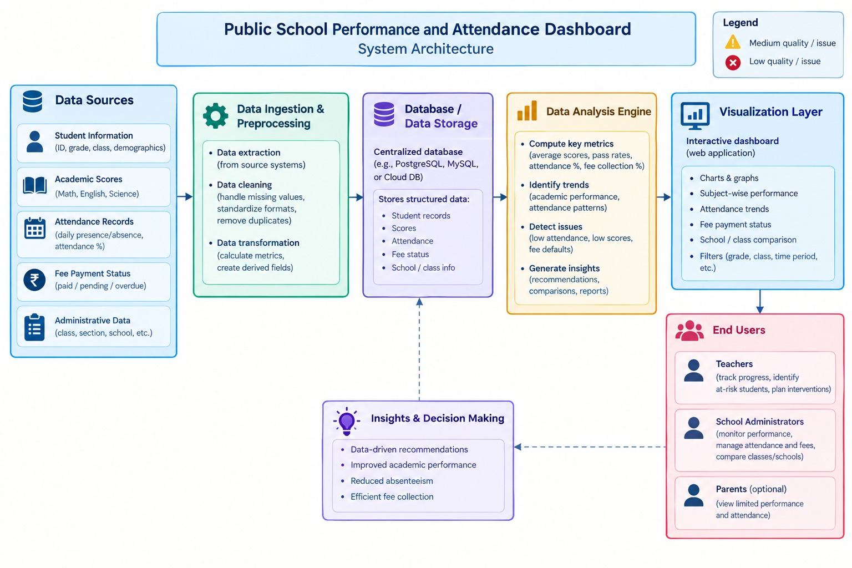
System Architecture / Ideation Map

Slide 8
Module Implementation
Student Management – Student details, class, attendance, and academic records.
Attendance Management – Daily attendance, absentees, attendance percentage, and trends.
Academic Performance – Marks, grades, subject-wise performance, and progress.
Dashboard & Analytics – Charts, graphs, performance comparison, and attendance insights.
Reports & Alerts – Generate reports and provide alerts for low attendance or poor performance.

Slide 9
Result And Discussion
The dashboard provides a single view of important student information.
Attendance percentages can be monitored easily.
Subject wise performance can be compared using charts.
Students requiring additional attention can be identified.
The system reduces manual data analysis and improves accessibility of information.

Slide 10
Conclusion
The Public School Performance and Attendance Dashboard provides an organized method for managing student attendance and academic performance.
It converts raw school data into simple visual information.
The system helps teachers and administrators monitor student progress efficiently.
It can be further enhanced with mobile applications, parent notifications, automated reports and AI-based analysis.

Slide 11
REFERENCES
Dataset : Public_School_Performance_Cleaned.csv
Software: Google Colab (Python , Pandas documentation).
Visualization : Microsoft Power BI Official DAX Reference Guide.

Slide 12
THANK YOU
We thank God, Our Department, Guide, Panel Members, Supportive Professors and all Technical and non Technical staff who helped us in our Project.

